Slide 1
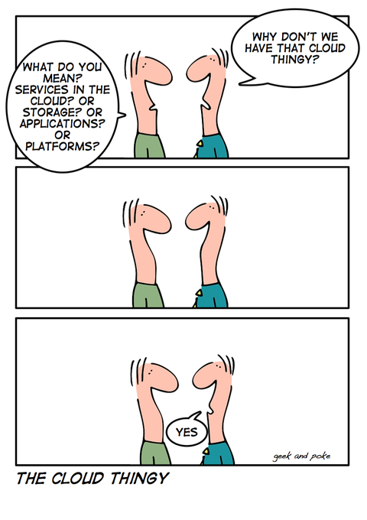
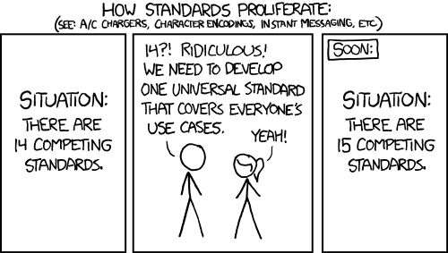
https://xkcd.com/927/
http://geek-and-poke.com/geekandpoke/2008/7/21/the-cloud-thingy.html

