Slide 1
Data Access and Re-use
Carl Johan Håkansson
EUDAT Service Area Manager
KTH Royal Institute of Technology

Slide 2
Data Access and Re-use Services
B2SHARE
B2DROP
B2FIND
B2ACCESS
Registry Services

Slide 3
Vision

Slide 5
Supportive services
AAI with B2ACCESS
EPIC Persistent Identifiers with B2HANDLE

Slide 6
Why B2SHARE?
Store
Share
Publish

Slide 7
Store in B2SHARE
Long tail data
Spreadsheets, images, documents, raw data
File size currently up to 2GB
Data that do not fit in with existing data management policies

Slide 8
Share
Share with colleagues all over the world
Share research data
Collaborate

Slide 9
Publish
Publish research results
Articles and papers
Documents
Raw data

Slide 10
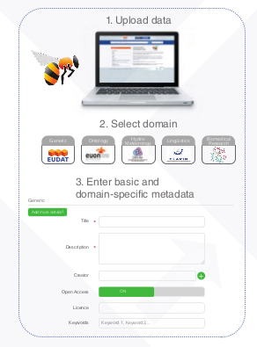
How?
Simplicity by design
10

Slide 11
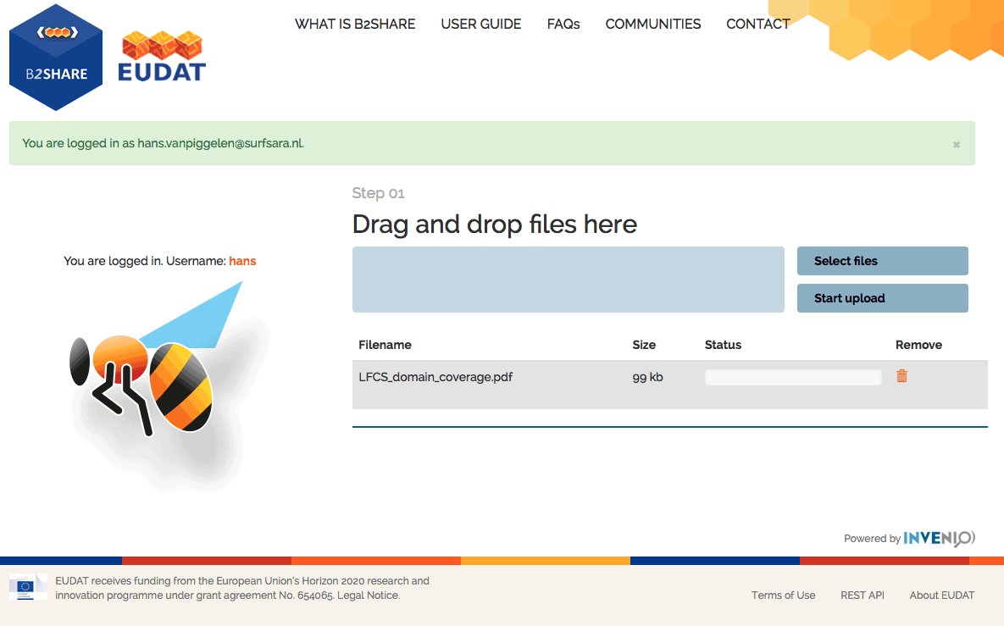
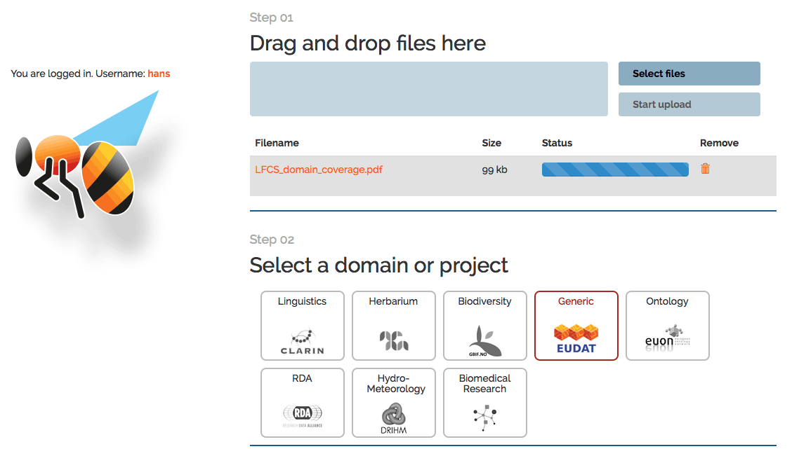
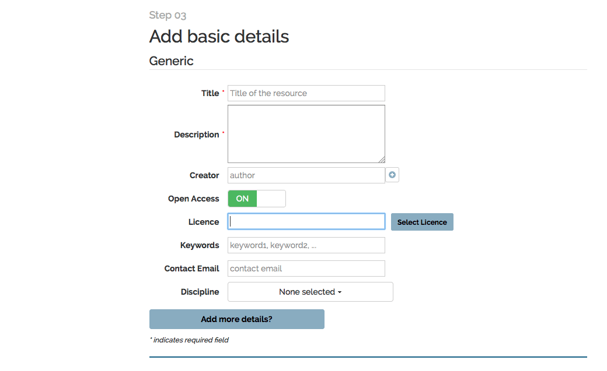
How do I deposit data? (2/2)
3 simple steps:
1. Select and upload one or several data resources either by dragging and dropping from your file browser
2. Select a domain or project specific metadata set to describe the resource(s)
3. Fill in the metadata form: the more information you add
the easier your data will be to find for others
Open Access:
Select “ON” to make your data accessible to registered members only
Select “OFF” and everyone can see your data

Slide 12
Roadmap Data Access and Re-Use Service Area
M12-M18
M19-M24
+M24
Mar 2016 – Aug 2016
Sep 2016 – Feb 2017
Mar 2017 – Feb 2018
B2SHARE | Release of B2SHARE 2.0 Authentication with B2ACCESS Integration with B2DROP Easy installation with Docker, Puppet and other tools New version of HTTP API New UI module Invenio 3 as backend Improved search scalability with ElasticSearch Pilot: integration with B2NOTE Pilot: B2SHARE as EUDAT CDI Metadata Store Integrate with DTR for pilot users | Support for cloud storage services like DropBox and Google Drive Support for more storage back-end solutions, e.g. cloud-storage and object stores Support versioning Support Digital Object Identifiers (DOIs) | Integration with the EUDAT Generic Execution Framework (GEF) Support for metadata extraction and data exploration via the GEF

Slide 13
Questions on B2SHARE?

Slide 14
B2DROP is...
B2DROP is a secure and trusted data exchange service for researchers and scientists to keep their research data synchronised and up-to-date and to exchange with other researchers.

Slide 15
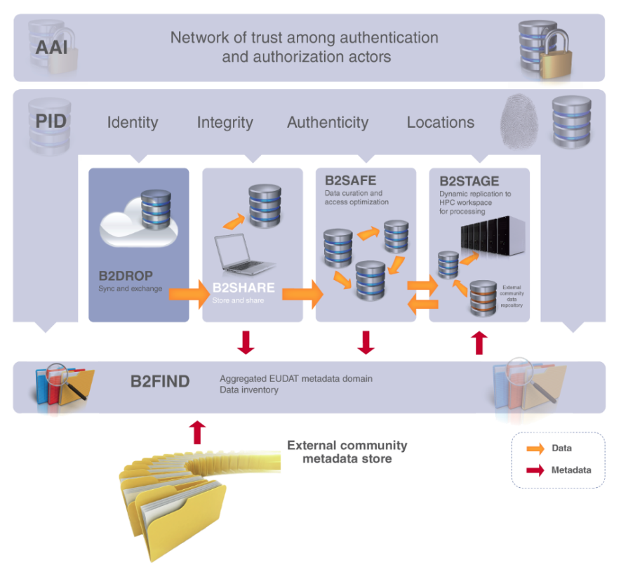
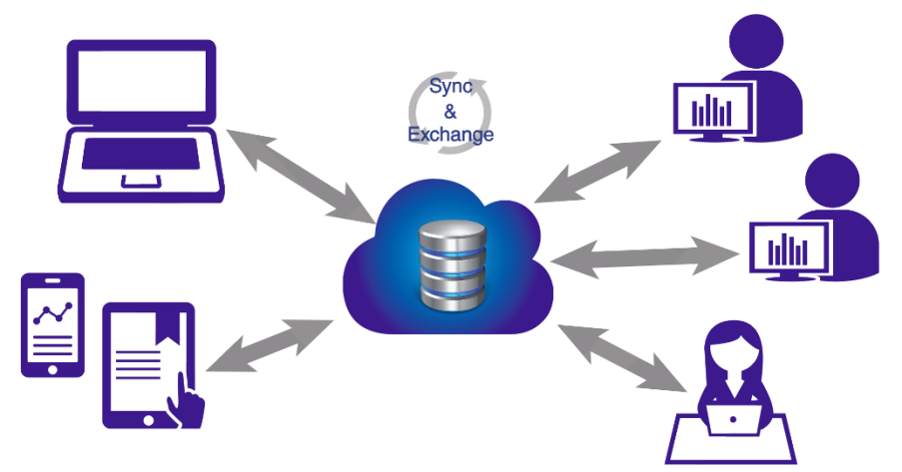
An ideal solution for researchers and scientists to:
Store and exchange data with colleagues and team members, including research data not finalized for publishing
share data with fine-grained access controls
synchronize multiple versions of data across different devices
Features:
20GB storage per user
Living objects, so no PIDs
Versioning and offline use
Desktop synchronisation

Slide 16
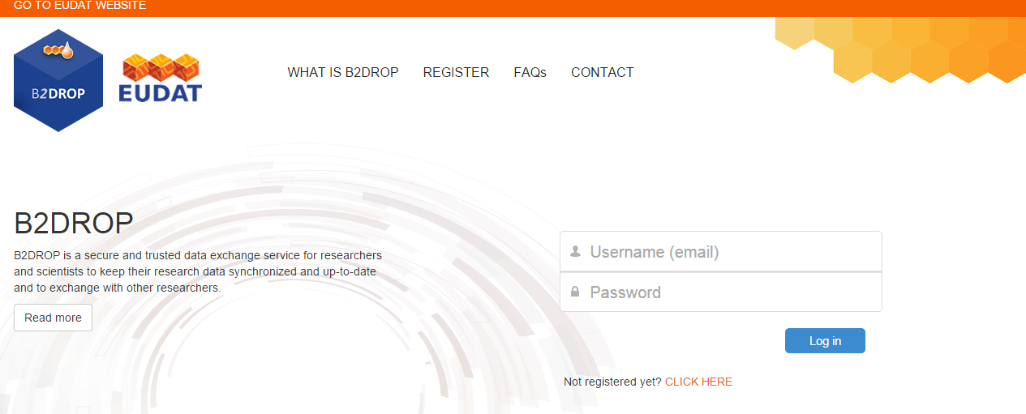
Register to use B2DROP
Easy and quick registration at https://b2drop.eudat.eu

Slide 17
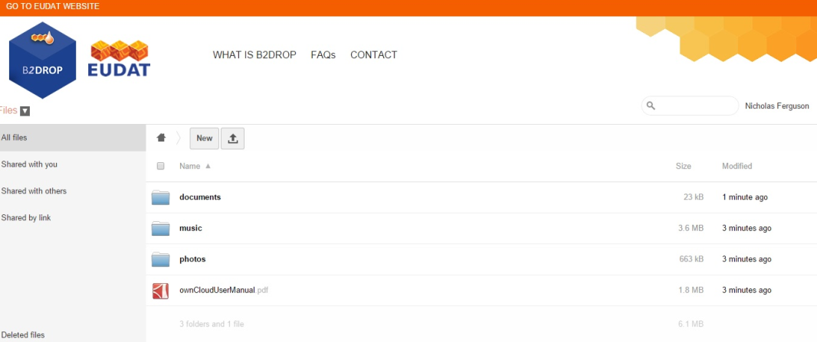
What can users do?
Users can
have access to 20GB of storage space for research data
access and manage files from any device and any location
define with whom to exchange data, for how long and how

Slide 18
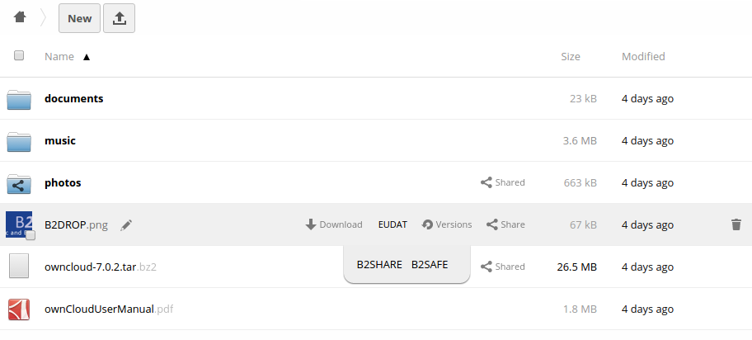
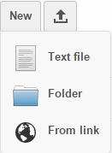
It’s simple to use
Intuitive and simple user interface
User-friendly interface and easy-to-use storage facilities
Drag or drop files for storage
Create new files and folders
Share data with others with one click

Slide 19
Synchronise your files
Synchronise B2DROP with your computer using ownCloud desktop clients by downloading the latest version of ownCloud Desktop Synchronization Client ownCloud Website.
MacOS
Linux Distributions
Windows
After download and installation enter the URL of the B2DROP ownCloud server https://b2drop.eudat.eu/ and enter your B2DROP username (e-mail address) and password.
Note that using this client allows you to work on your files while offline, and synchronise when you reconnect to the network.

Slide 20
Mount your folder
You can mount B2DROP as a drive to your desktop machines via WebDAV
Your B2DROP folder then appears in your file browser
You can work on files, which will synchronise automatically with the B2DROP server on save
Supported for
MacOS
Linux Distributions
Windows
Note that mounting your folder through WebDAV only works while you are connected to the network.

Slide 21
B2DROP Supports versioning
Automatic file versioning
Access to the previous versions is straightforward on the web GUI and the desktop client
The latest file gets overwritten by the selected version, with other versions (including newer) retained.
To preserve disk space, B2DROP preserves a subset of the versions, progressively reducing the number of retained versions as time goes by.
Note that B2DROP removes older saved versions and/or stops maintaining versions when the user exceeds 50% of their quota.

Slide 22
How & Where are my data stored
B2DROP is hosted at the Jülich Supercomputing Centre
Daily backups of all files in B2DROP are taken and kept on tape.
Underlying technology is ownCloud 7

Slide 23
Roadmap Data Access and Re-Use Service Area
M12-M18
M19-M24
+M24
Mar 2016 – Aug 2016
Sep 2016 – Feb 2017
Mar 2017 – Feb 2018
B2DROP | Integrated with B2SHARE Integrated with B2ACCESS Deployment with Puppet and Docker | Improvments based on change requests from communities and partners | Improvments based on change requests from communities and partners

Slide 24
Questions on B2DROP?

Slide 25
B2FIND is...
… a simple, user-friendly
discovery service based on metadata steadily harvested from research data collections from EUDAT data centres and other repositories

Slide 26
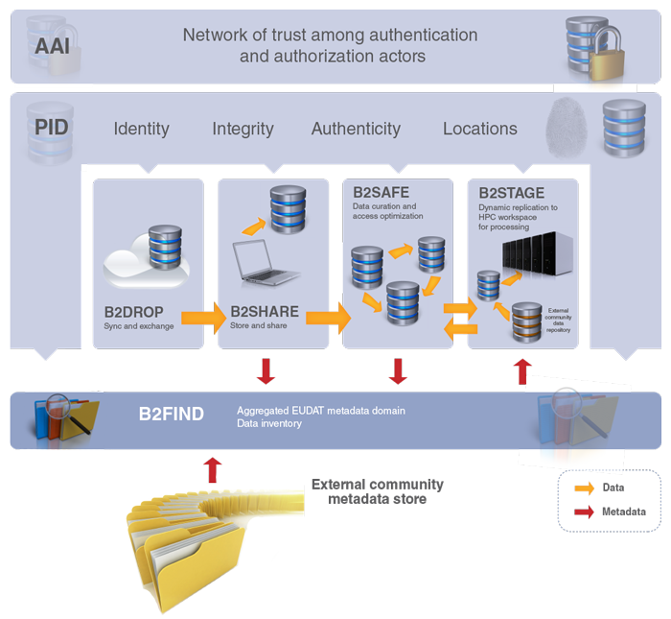
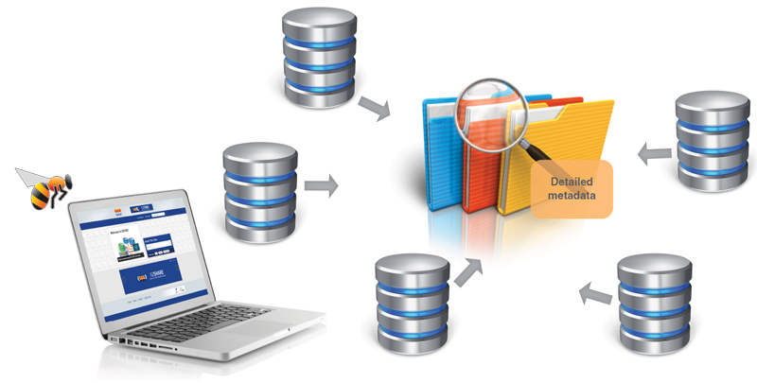
What is B2FIND?
A metadata catalogue service to:
Find collections of scientific data quickly and easily, irrespective of their origin, discipline or community
Get quick overviews of available data
Browse through collections using standardized facets
Features:
simple to use
standards-based
comprehensive catalogue

Slide 27
Data from a huge selection of subjects
B2FIND has a truly cross-community approach
Metadata is mapped and harvested from a range of communities:
From climate research to social sciences
From biodiversity to linguistics
From archaeology to seismology

Slide 28
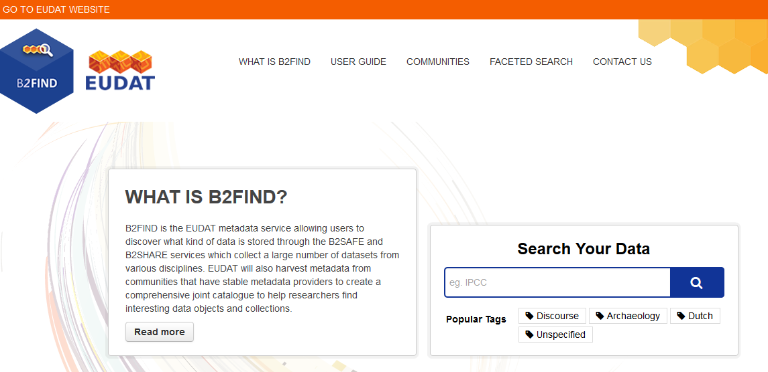
How to search and browse datasets
Go to http://b2find.eudat.eu

Slide 29
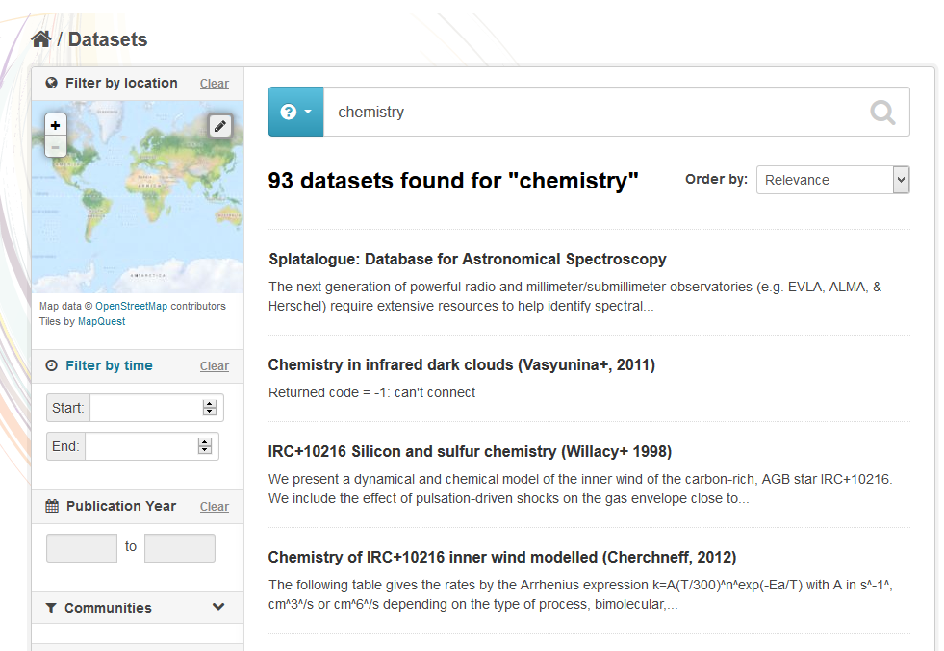
How to search and browse datasets
Search and browse all data sets via Keyword searches
Results displayed in an easy to read format and listed in order of relevance to your search

Slide 30
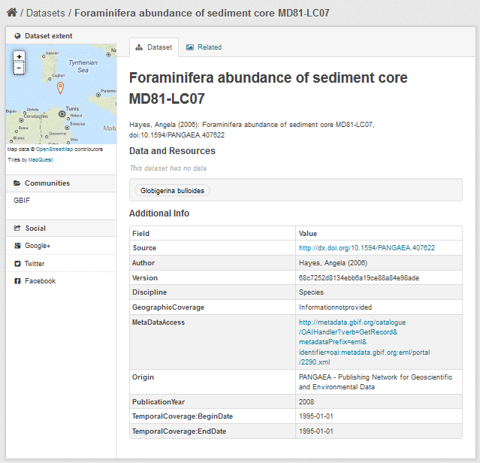
Detailed information on all datasets
Spatial coverage
Abstract
Detailed metadata
Author
Version
Discipline
Source
Format
Geographical description
Metadata access
Origin
Publication Time stamp
Year of publication
Rights

Slide 31
Roadmap Data Access and Re-Use Service Area
M12-M18
M19-M24
+M24
Mar 2016 – Aug 2016
Sep 2016 – Feb 2017
Mar 2017 – Feb 2018
B2FIND | Continued community integration Improved user experience Resolve granularity issues Integration with B2NOTE Performance and scalability improvements | Customisation of GUI for communities Prototype of SRU interface Extend harvesting methodes (OGC / CSW ) Improved search functionalities for hierarchical search and taxonomies Improved semantic mapping | SRU interface in production Integrate with EUDAT CDI Metadata Store Integration with Data Type Registry

Slide 32
Questions on B2FIND?

Slide 33
EUDAT Federated Authentication and Authorisation Infrastructure

Slide 34
Federated AAI and Role Based Access Control
Self-registration: e-mail address only requirement
Supporting OpenID (Google, Facebook, ...)
EduGAIN supported

Slide 35
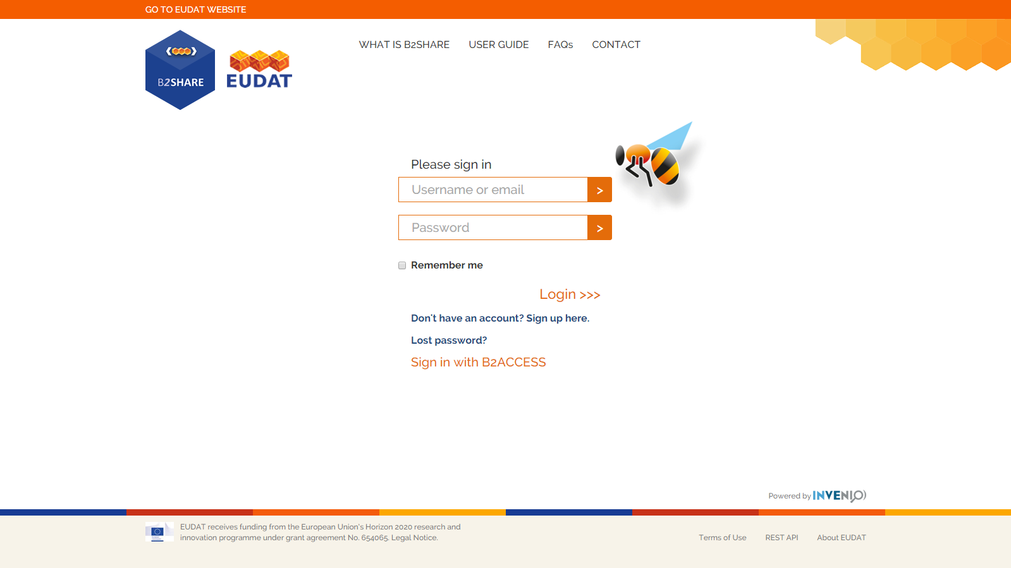
Integrated in B2SHARE: ”Sign in with B2ACCESS”

Slide 36
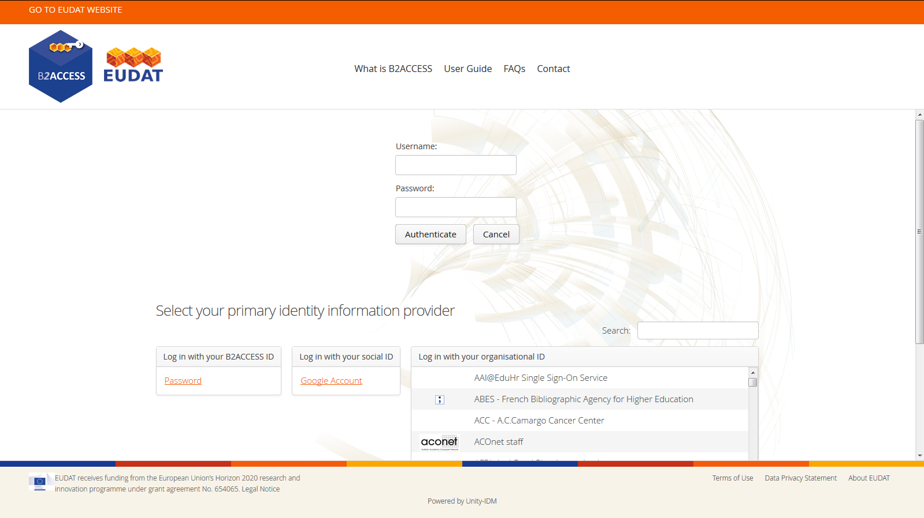
Login through B2ACCESS

Slide 37
Roadmap Data Access and Re-Use Service Area
M12-M18
M19-M24
+M24
Mar 2016 – Aug 2016
Sep 2016 – Feb 2017
Mar 2017 – Feb 2018
B2ACCESS | B2SHARE integrated with B2ACCESS for authentication Integration with Data Type Registry pilot Integration with EUDAT CDI common HTTP REST API Integration with B2SAFE & DPM Integration with B2DROP Integration with B2STAGE Integration with Data Project Coordination Portal Installation packages & distributed setup Pilot for XACML based authorisation solution | Support for integration with external community sites Integration with PRACE Integration with EGI Distributed authorisation | Complete integration with external community sites Complete integration with PRACE Complete integration with EGI Improvements based on change requests from communities and partners

Slide 38
Questions on B2ACCESS?

Slide 39
The Registry Services
M12-M18
M19-M24
+M24
Mar 2016 – Aug 2016
Sep 2016 – Feb 2017
Mar 2017 – Feb 2018
Registry Services | Pilot instance of the Data Type Registry Collaborate with pilot communities on further evaluation and adaptation of the DTR Integrate the DTR pilot with B2ACCESS for Federated AAI Integration of the pilot DTR with B2SHARE and B2FIND | Further development of the DTR based on feedback from communities and other EUDAT services Integration of the DTR with B2NOTE | Evaluate DTR pilot Bring DTR into production Integrate DTR with other EUDAT services based on pilot evaluation

Slide 40
Questions and discussion

