Slide 1
The EUDAT Services Suite and how it could support FAIR data
Sarah Jones, Marjan Grootveld, Yann Le Franc
iDCC conference, February 20, 2017
This work is licensed under the Creative Commons CC-BY 4.0 licence.
Attribution: EUDAT – www.eudat.eu
Version 2017-1
Notes:
This presentation introduces the EUDAT Services Suite and is aimed at a general public. It also provides information on the organization that develops, maintains and deploys the services: the EUDAT initiative. The EUDAT Services Suite is a number of data services supporting researchers, research communities and research infrastructures.
Detailed information on the services can be found at eudat.eu/services.
This presentation consists of 28 slides and will take 15 minutes.

Slide 2
Agenda
EUDAT services – Sarah Jones
FAIR principles – Marjan Grootveld
HerbaDrop data pilot – Rob Cubey
DataPublication @ U. Porto – Joao Aguiar Castro
Coffee / tea break
Hands-on service exploration – Yann le Franc
Drop-in clinic: everything you always … - all
Slides will become available afterwards.

Slide 3
EUDAT Services Suite
EUDAT offers a complete set of research data services, expertise and technology solutions to all European scientists and researchers.
These shared services and storage resources are distributed across 15 European countries.
Data are safely stored alongside some of Europe’s most powerful supercomputers.
Notes:
The EUDAT Service Suite offers a complete set of research data services, expertise and technology solutions to all European scientists and researchers.
These services and storage resources are distributed across 15 European countries.
The data are safely stored alongside some of Europe’s most powerful supercomputers.

Slide 4
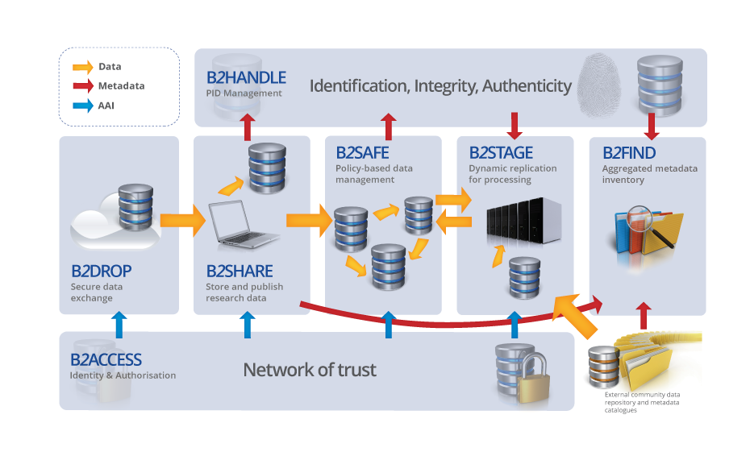
EUDAT Services Suite
http://www.eudat.eu/services
Notes:
EUDAT has built a suite of seven integrated services that enables the storage, sharing and analysis of research data. More details on these services are given further on in this presentation.
The context of the EUDAT Services Suite is illustrated in the model on the right. A couple of components support the quality and integration of the services. Authorization and authentication services, for instance, provide controlled access to the data and services. Another example is the services creating, granting and maintaining persistent identifiers to data objects.

Slide 5
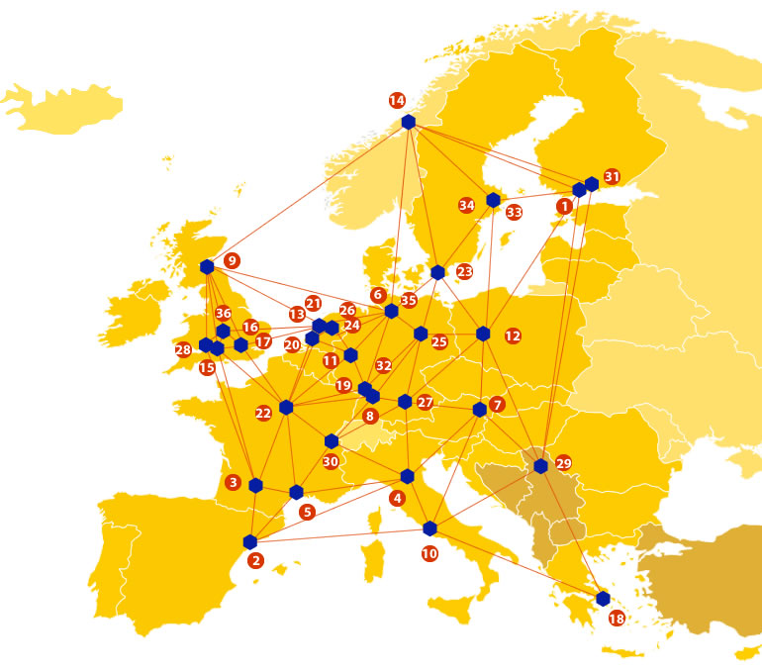
A truly pan-European Infrastructure
EUDAT offers common data services, supporting multiple research communities as well as individuals, through a geographically distributed, resilient network of 36 European organisations
Our vision is to enable European researchers and practitioners from any research discipline to preserve, find, access, and process data in a trusted environment, as part of a Collaborative Data Infrastructure
Notes:
The EUDAT consortium consists of 36 partners which include high performance computing centers, data centers, libraries, scientific communities and data scientists.
The EUDAT vision is to enable European researchers and practitioners from any research discipline to preserve, find, access, and process data in a trusted environment.

Slide 6
Community-Driven Solutions
EUDAT services are designed, built and implemented based on user community requirements.
Notes:
EUDAT cooperates with a wide variety of research communities, such as the medical and biomedical sciences, environmental sciences, materials and analytical facilities, social sciences and humanities and physical sciences and engineering.
EUDAT has concrete agreements with 7 core communities, an integral part of the initiative, namely:
CLARIN: Common Language Resources and Technology Infrastructure
ELIXIR: A distributed infrastructure for life-science information
ENES: European Network for Earth System Modelling
EPOS: European Plate Observing System
ICOS: Integrated Carbon Observation System
LTER Europe: European Long Term Ecological Research Network
VPH: Virtual Physiological Human
EUDAT works on a Collaborative Data Infrastructure conceived as a network of collaborating, cooperating centers, combining the richness of numerous community specific data repositories with the permanence and persistence of some of Europe’s largest scientific data centers.

Slide 7
B2DROP
EUDAT’s Personal Cloud Storage Service
B2DROP is a secure and trusted data exchange service for researchers and scientists to keep their research data synchronized and up-to-date and to exchange with others.
Notes:
The EUDAT Services Suite consists of seven services. Each service is presented in the following slides, starting with B2DROP.
The B2DROP service can be characterized as a personal cloud storage service. It is a secure and trusted data exchange service.

Slide 8
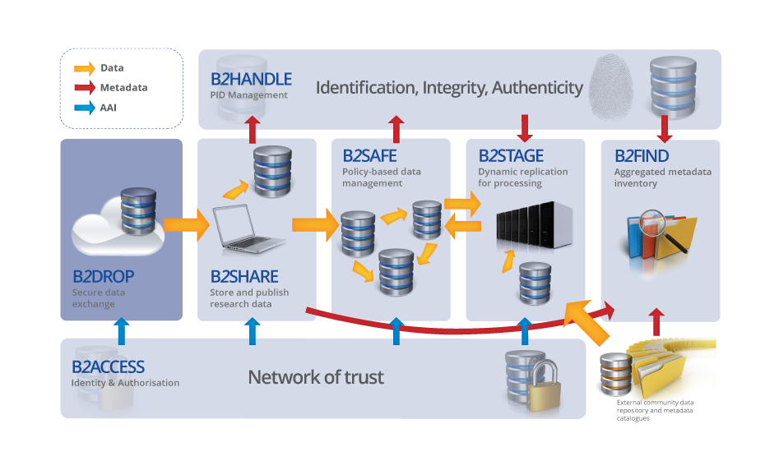
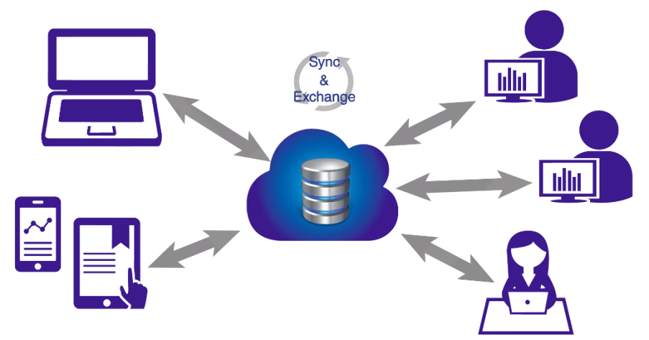
An ideal solution for researchers and scientists to:
Store and exchange data with colleagues and team members, including research data not finalized for publishing
share data with fine-grained access controls
synchronize multiple versions of data across different devices
Features:
20 GB storage per user
Living objects, so no PIDs
Versioning and offline use
Desktop synchronisation
Notes:
The B2DROP service is a cloud solution to store and share data in the early state of the research data life cycle. It is aimed at individual researchers and enables the storage and exchange of data with colleagues and team members. Data can be shared with fine-grained access controls. B2DROP synchronizes multiple versions of data across different devices and platforms. B2DROP users are offered up to 20 GB of storage space for their data.
The B2DROP service can be found at b2drop.eudat.eu.

Slide 9
B2SHARE
B2SHARE is a user-friendly, reliable and trustworthy way for researchers, scientific communities and scientists to store and share small-scale research data from diverse contexts.
Notes:
The next service of the EUDAT Services Suite is the B2SHARE service to store and share small-scale research data form diverse contexts.

Slide 10
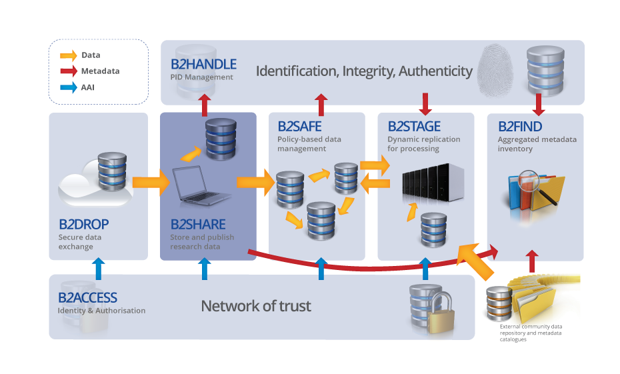
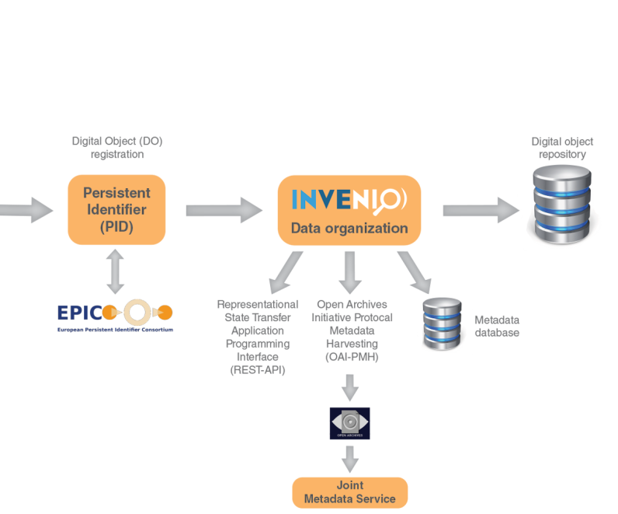
A winning solution for researchers, scientists and communities to:
store data safely at a trusted and certified data centre
preserve data to guarantee long-term persistence
control access and share data with colleagues and the world
Features:
Metadata management
Permanent PIDs
Open Access support
Notes:
The B2SHARE service is aimed at individual researchers. It has been integrated in a number of research infrastructures and EUDAT defines custom made community based metadata schema templates to facilitate users.
B2SHARE facilitates data storage in a trusted and certified repository that guarantees long-term persistence of the data. Data objects get a persistent identifier. Depositors can document their data objects and give the data a usage license, preferably an open access license.
The B2SHARE service can be found at b2share.eudat.eu.

Slide 11
B2SAFE
B2SAFE is a robust, safe and highly available service which allows community and departmental repositories to implement data management policies on research data across multiple administrative domains in a trustworthy manner.
Notes:
The third service of the EUDAT Services Suite is the B2SAFE service.
This service allows community and department repositories to implement data management policies on research data across multiple administrative domains.

Slide 12
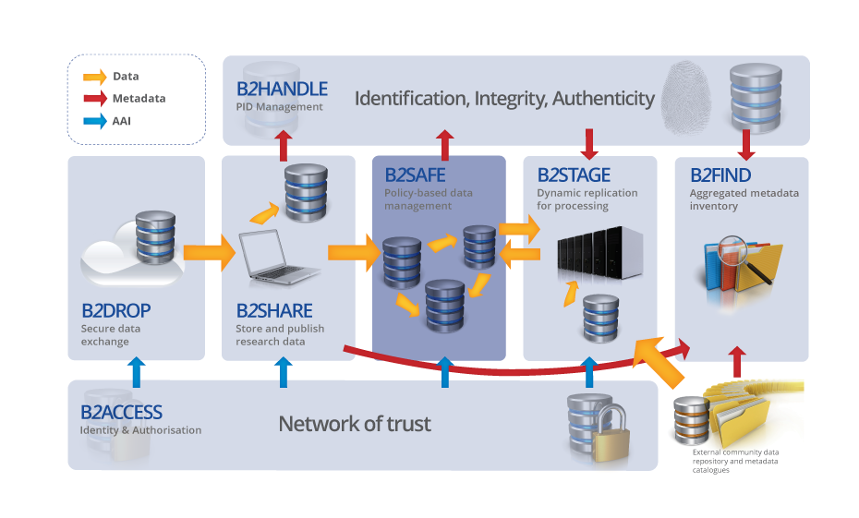
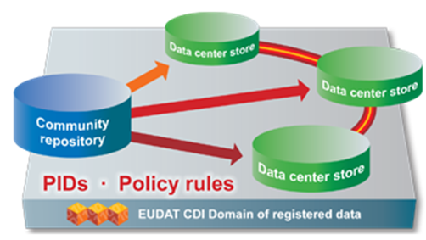
The ideal solution for communities with no facility for archival to:
replicate research data into secure data stores
archive and preserve research data in the long-term
bring data close to powerful compute resources
co-locate data with different communities
benefit from economies of scale
Features:
Large-scale storage
Robust and highly available
Permanent PIDs
Notes:
The B2SAFE service is aimed at research communities that have no facilities for archival data storage. The service supports a number of procedures such as data replication and the co-location of data with different communities. B2SAFE facilitates high-scale petabytes storage.
More information on the B2SAFE service can be found at eudat.eu/b2safe.

Slide 13
B2STAGE
B2STAGE is a reliable, efficient, light-weight and easy-to-use service to transfer research data sets between EUDAT storage resources and high-performance computing (HPC) workspaces
Notes:
The B2STAGE service enables the movement of large amounts of data between data stores and high-performance computing resources.

Slide 14
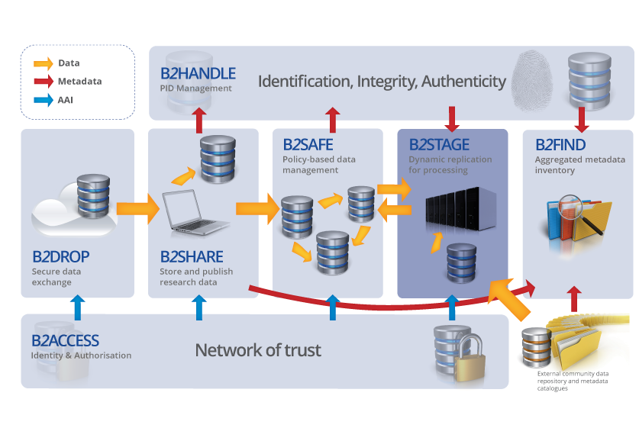
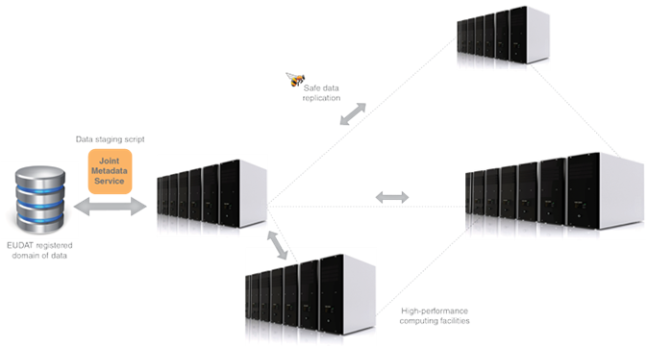
Facilitating communities to:
move large amounts of data between data stores and high-performance compute resources
re-ingest computational results back into EUDAT
deposit large data sets onto EUDAT resources for long-term preservation
Features:
High-speed transfer
Reliable and light-weight
Manages permanent PIDs
Notes:
The B2STAGE service is aimed at research communities and infrastructures to move large amounts of data between data stores and high-performance computing resources, to re-ingest computational results back into EUDAT and to deposit large data sets onto EUDAT resources for long-term preservation.
More information on the B2STAGE service can be found at: eudat.eu/b2stage.

Slide 15
B2FIND
B2FIND is a simple, user-friendly metadata catalogue of research data collections stored in EUDAT data centres and other repositories.
Notes:
The last service of the EUDAT Service Suite is the B2FIND service. It can be characterized as a simple, user-friendly metadata catalogue of research data collections stored in EUDAT data centers and other repositories.

Slide 16
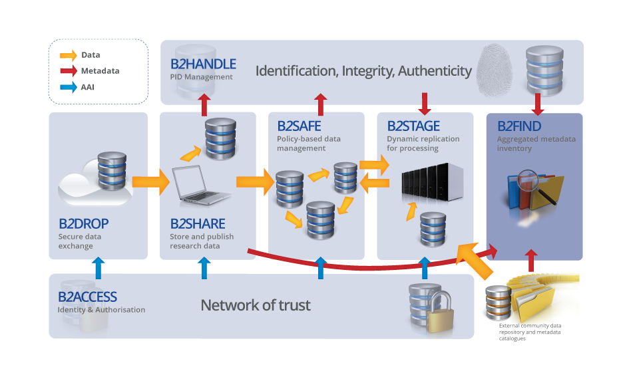
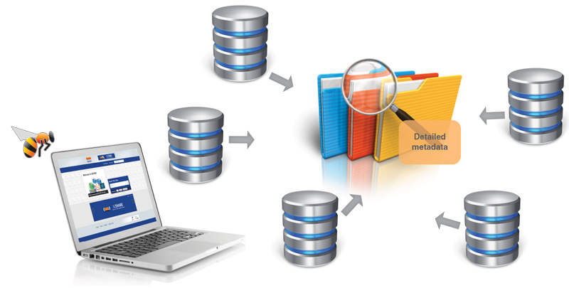
A metadata catalogue service to:
seek data objects and collections using powerful metadata searches
catalogue community data by means of selected metadata
browse through multi-disciplinary data collections filtered by content, provenance and temporal keywords
Features:
Simple to use
Standards-based
Comprehensive catalogue
Notes:
The B2FIND service enables the searching and browsing for data objects and collections and supports a number of metadata formats. B2FIND facilitates browsing through multi-disciplinary data collections.
More information on the B2FIND service can be found at: https://b2find.eudat.eu.

Slide 17
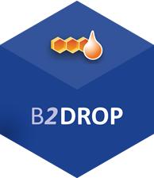
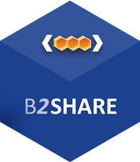
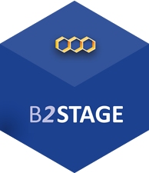
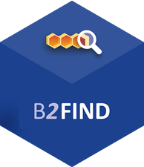
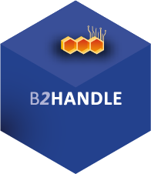
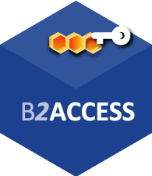
For more info:
b2drop.eudat.eu
eudat.eu/services/userdoc/b2drop
b2share.eudat.eu
eudat.eu/services/userdoc/b2share
eudat.eu/services/userdoc/b2safe
eudat.eu/b2stage
eudat.eu/services/userdoc/b2stage
b2find.eudat.eu
eudat.eu/services/userdoc/b2find
eudat.eu/services/userdoc/b2handle
b2access.eudat.eu
eudat.eu/services/userdoc/b2access-usage
Notes:
Most of the EUDAT services have their dedicated service domain and documentation. For all services documentation, tutorials and training are in the making or already exist.
The service suite will be enhanced and expanded. So keep in touch. If you have any questions or remarks concerning the services or the EUDAT initiative, please use the contact form available at the EUDAT website: eudat.eu.

Slide 18
What is FAIR data?
Findable
assign persistent IDs, provide rich metadata, register in a searchable resource...
Accessible
Retrievable by their ID using a standard protocol, metadata remain accessible even if data aren’t...
Interoperable
Use formal, broadly applicable languages, use standard vocabularies, qualified references...
Reusable
Rich, accurate metadata, clear licences, provenance, use of community standards...
www.force11.org/group/fairgroup/fairprinciples
http://www.nature.com/articles/sdata201618

Slide 19
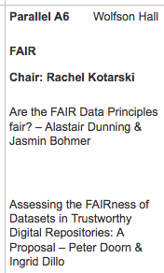
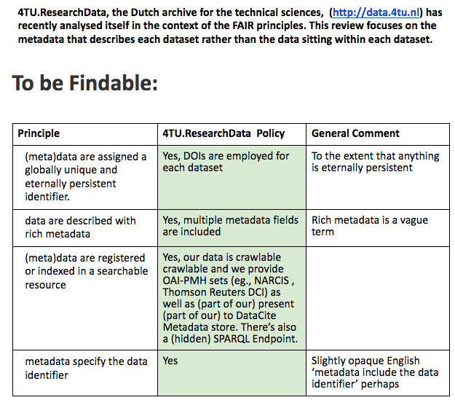
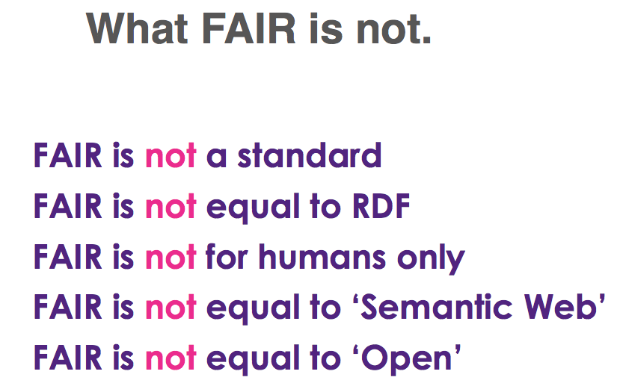
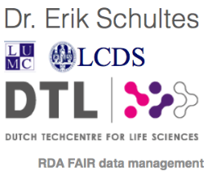
Principles =/= practice
Lots of attempts to put the FAIR principles into practice
FAIR session iDCC, Wednesday 16.00-16.40
Notes:
Worldwide, lots of organisations and individuals are trying to transform the principles into practice. That’s not easy:
differences between the principles on the Force11 site and the principles in the Scientific Data article;
huge variation among disciplines;
a gap between high-level principles and daily practice;
different interpretations/opinions regarding ‘are all principles about machines AND about humans’ – heavily related to the state of the art in different disciplines.
There are presentations this Wednesday afternoon about interpreting and applying the principles to data repositories, and about dataset properties that could be used to assess the level of FAIRness.
Another perspective to scope the principles is to clearly state what they are NOT, as Erik Schultes did at an RDN meeting last year.

Slide 20
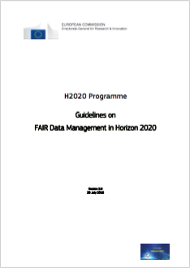
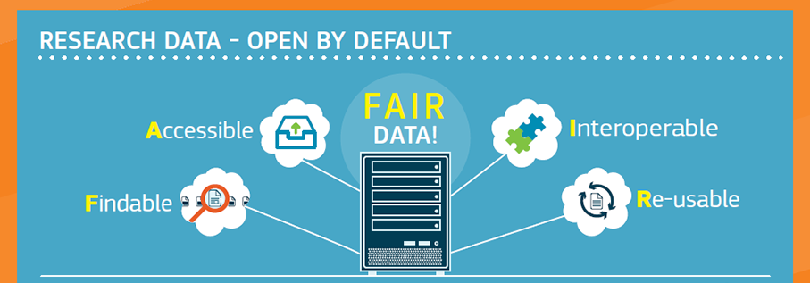
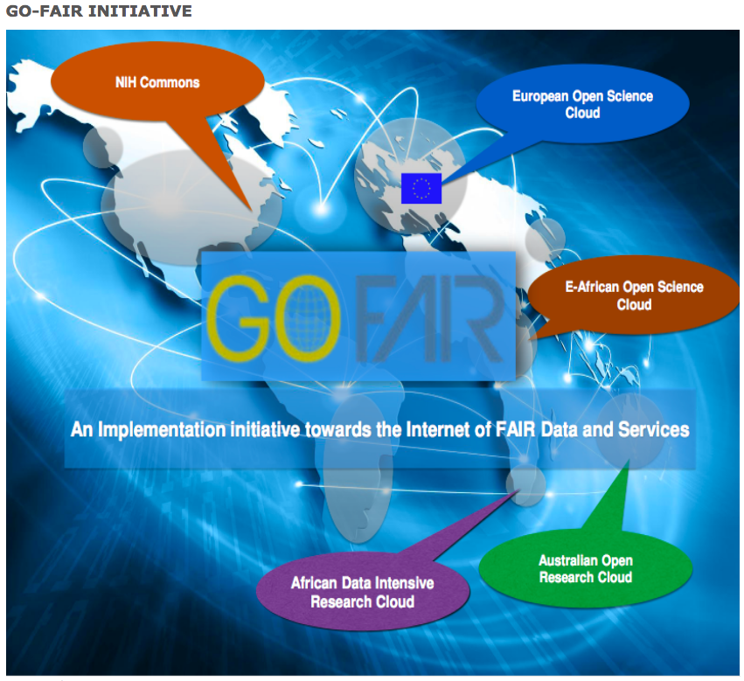
Principles =/= practice
European Commission, H2020: “This template is not intended as a strict technical implementation of the FAIR principles, it is rather inspired by FAIR as a general concept.”
EC Guidelines for FAIR Data Management http://ec.europa.eu/research/participants/data/ref/h2020/grants_manual/hi/oa_pilot/h2020-hi-oa-data-mgt_en.pdf
EC Infographic http://ec.europa.eu/research/images/infographics/policy/open-data-2016-w920.png
GO FAIR http://www.dtls.nl/go-fair/
20
Notes:
Also the EC was inspired by the FAIR principles: all new Horizon2020 projects have to deliver a DMP which tells how the project will deliver FAIR data.
DTL – Dutch TechCentre for Life Sciences – is also the organisation that supports the GO FAIR initiative, although that will broader than the life sciences

Slide 21
FAIR support in EUDAT
EUDAT “FAIR data pilot”
The B2 services
Notes:
Among the many data pilots that EUDAT supports, there is one that is explicitly devoted to analysing the EUDAT services with a view to what is needed to make them comply with the FAIR principles. This is a going concern and we will certainly come back to it in later workshops.
Today, however, we want to use the time to let you explore some of the services, so the following overview of how EUDAT services support particular FAIR elements will be brief. Also, part of the FAIR support is an ambition and not 100% robust.

Slide 22
Simplified life cycle with FAIR support
Creating data
Processing data
Analysing data
Preserving data
Giving access to data
Re-using data
PIDs → Referencing data:
Finding data and making data findable
HPC Data Transfer from public data servers with B2STAGE
Document what you do;
Store your mutable data in B2DROP
Metadata support findability and the decision to reuse; should be interoperable itself
Use B2ACCESS for secure access to EUDAT services
Move data to HPC with B2STAGE;
Keep documenting
Promote Open / Restricted access to data – invite reuse;
Annotate the data with B2NOTE
Deposit data with metadata and documentation for interoperability and reuse
Notes:
When we do a full presentation of all the EUDAT services, we flesh out the data life cycle with more EUDAT services.
Today, however, we focus on the services that support implementation of the FAIR data principles.

Slide 23
EUDAT & Findable
B2FIND: multi-disciplinary metadata catalogue
now: common metadata catalogue, harvesting across all CDI data, single point for data discoverability;
in development: aim to improve with agreed basic metadata for all data objects.
B2SHARE: research data repository
now: full, tailored metadata support for data deposits.

Slide 24
EUDAT & Accessible
B2HANDLE: PID management
now: common PID mechanism across all CDI data;
in development: aim to improve with agreed common schema and behaviour.
Other services
now: EUDAT presents data through common Internet protocols and APIs, http and gridftp;
in development: aim to improve with a single http API for all services and data.

Slide 25
Interoperability
In the aftermath of the French Revolution (1789), the traditional units of measure used in the Ancien Régime were replaced. The livre monetary unit was replaced by the decimal franc, and a new unit of length was introduced which became known as the metre. The metre gained adoption in continental Europe during the mid nineteenth century, particularly in scientific usage, and was officially established as an international measurement unit by the Metre Convention of 1875.
Before clocks were invented, people kept time using different instruments to observe the Sun’s zenith at noon. Towns and cities set clocks based on sunsets and sunrises. Time calculation became a serious problem for people travelling by train, sometimes hundreds of miles in a day. UTC is the World's Time Standard.
Medical classification is the process of transforming descriptions of medical diagnoses and procedures into universal medical code numbers. SNOMED Clinical Terms (SNOMED CT) is intended to provide a set of concepts and relationships that offers a common reference point for comparison and aggregation of data about the health care process. SNOMED-CT is designed to be managed by computer.
A440, which has a frequency of 440 Hz, is the musical note A above middle C and serves as a general tuning standard for musical pitch. Prior to the standardization on 440 Hz, many countries and organizations followed the Austrian government's 1885 recommendation of 435 Hz. In the period instrument movement, a consensus has arisen around a modern baroque pitch of 415 Hz (A♭ of A440), baroque for some special church music (Chorton pitch) at 466 Hz (A♯ of A440), and classical pitch at 430 Hz.
25
Notes:
Interoperability is often considered the most problematic one. However, we humans have a long history of reaching consensus, standards, and common reference points. So the degree of interoperability will clearly vary between disciplines and that’s ok, as long as we see it as an ambition and a goal for the disciplines we work in.

Slide 26
EUDAT & Interoperable
B2FIND: multi-disciplinary metadata catalogue
in development: agreed basic metadata for all data objects (a degree of metadata interoperability).
B2SAFE: policy-driven data management
in development: single http API for all services and data (interoperability of data services, if not data!).
B2NOTE: annotate research data
now a pilot: supports Linked Data and uses ontologies

Slide 27
EUDAT & Reusable
B2SHARE: research data repository
B2SAFE: policy-driven data management
now: encourage use of CC BY v 3 as common open data licence; encourage open formats where we have any influence.
EUDAT licensing wizard
help you pick licence for data & software http://ufal.github.io/public-license-selector/
Notes:
Remember to give also your open data and software a proper licence.
The OA guidelines under Horizon 2020 point to CC-0 or CC-BY as a straightforward and effective way to make it possible for others to mine, exploit and reproduce the data. See p11 at: http://ec.europa.eu/research/participants/data/ref/h2020/grants_manual/hi/oa_pilot/h2020-hi-oa-pilot-guide_en.pdf

Slide 28
Thank you!
Hilary Hanahoe, Trust-IT
Kostas Kavoussanakis, EPCC
René van Horik, DANS
Hans van Piggelen, SURFsara
Marjan Grootveld, DANS
Christine Staiger, SURFsara
Mark van de Sanden, SURFsara
https://eudat.eu/training

